Slide 1
Session 1. Sudden Cardiac Death: Risk Stratification and Management
Risk Stratification of SCD
in Post MI Patients/Nonischemic CM Patients
Youngjin Cho, M.D.
Seoul National University Bundang Hospital

Slide 2
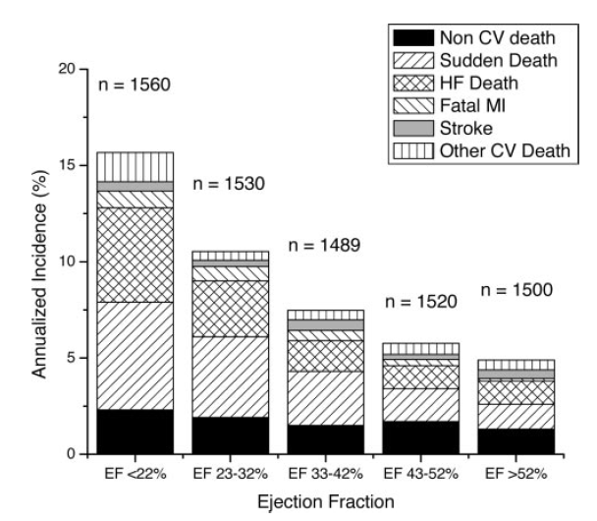
LVEF, a predictor of cardiovascular outcome
LVEF is a powerful predictor of cardiovascular outcome
Circulation 2005;112:3738-44

Slide 3
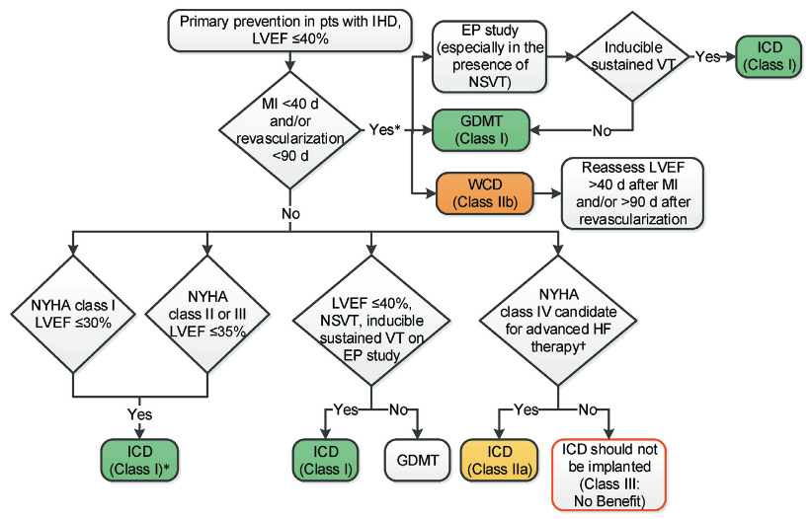
Primary prevention of SCD in Pts with IHD
2017 ACC/AHA/HRS VA/SCD guideline

Slide 4
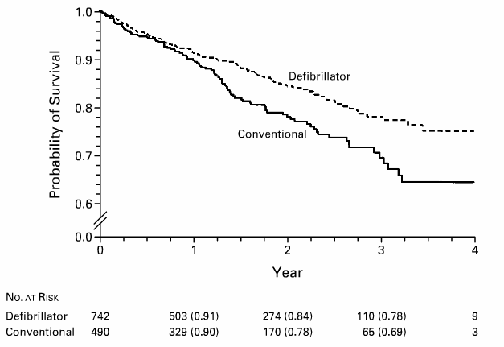
MADIT-II trial
Pts with prior MI history, EF < 30%
Moss et al. NEJM. 2002

Slide 5
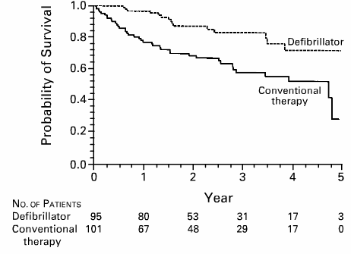
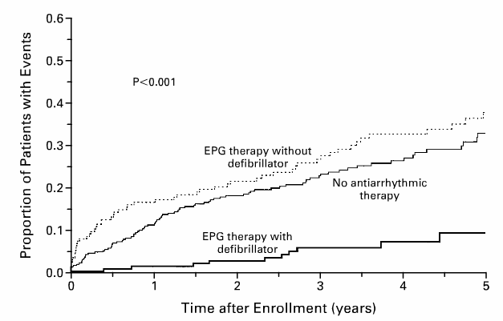
EPS guided ICD implantation
MADIT-I trial
MUSTT trial
Pts with CAD, EF <35% with ASx NS-VT
Inducible VT by Programmed stim
Pts with CAD, EF <40% with ASx NS-VT
Inducible VT by Programmed stim
Moss et al. NEJM. 1996
Buxton et al. NEJM. 1999

Slide 6
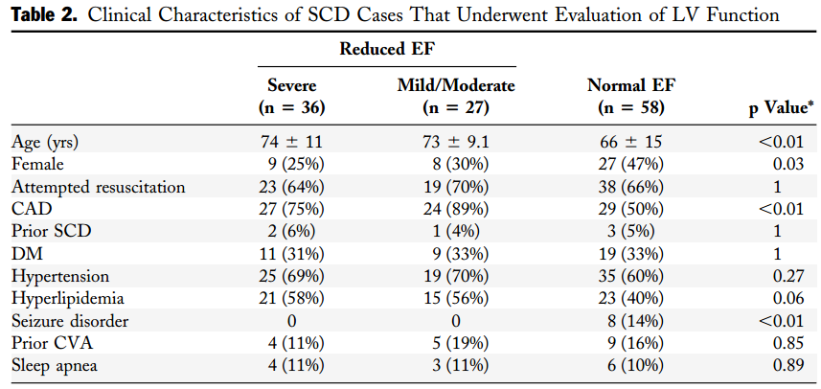
Limitation of LVEF for prediction of SCD
Population-based study
All cases of SCD in Multnomach Country, Oregon
714 SCD cases / 121 with LV functional analysis
70%

Slide 7
Limitations of LVEF
LVEF ≠ contractility
Poor contractile function ≠ tendency to arrhythmias
Suboptimal accuracy, precision, and reproducibility

Slide 8
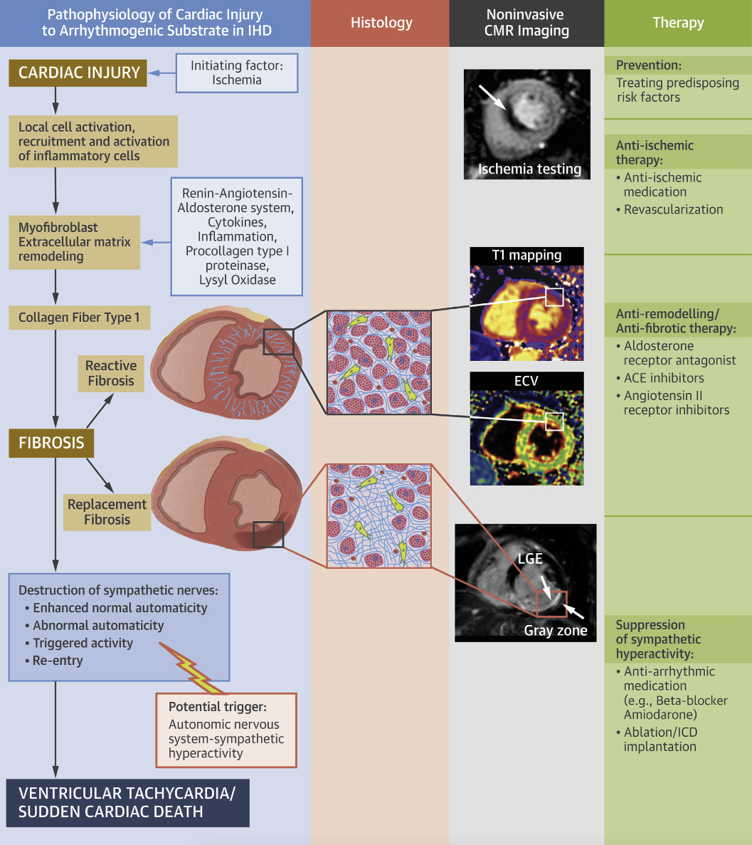
Gräni, C. et al. JACC Img. 2020;13(10):2223–38.
Notes:
The pathophysiology of initial cardiac injury with local cell activation and differentiation to myoﬁbroblasts, progression to extracellular matrix, and ﬁnally to collagen ﬁber type 1 proliferation with reactive and replacement ﬁbrosis as the arrhythmogenic substrate with its different mechanisms is depicted. Cardiac magnetic resonance can image ischemia and ﬁbrosis using late gadolinium enhancement, T1 mapping, and extracellular volume fraction. Current treatments are using preventive measurements and pharmacological antiremodeling/antiﬁbrotic medications or ablate the arrhythmogenic substrate and implantable cardioverter-deﬁbrillator.

Slide 9
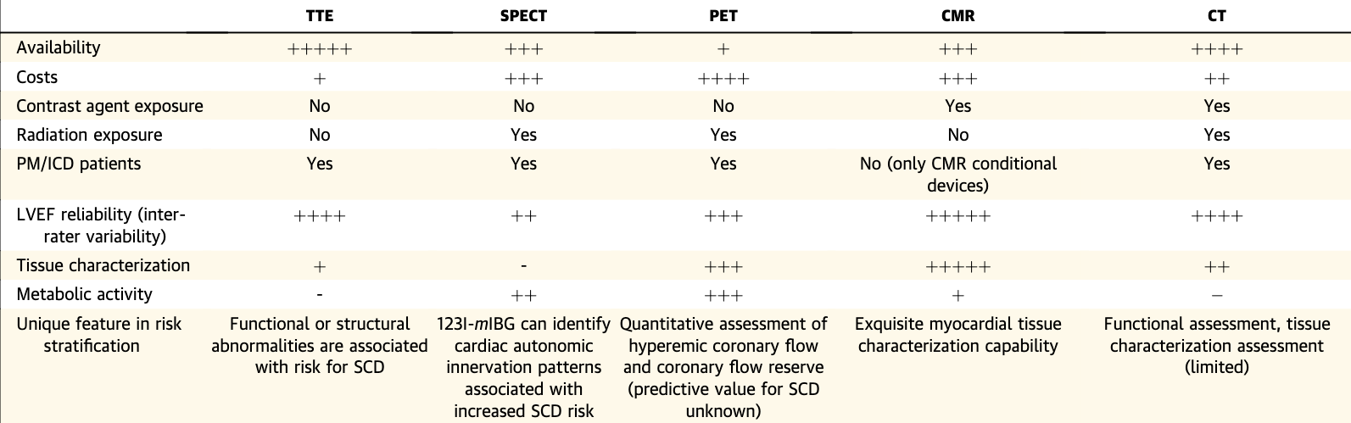
Modalities for Risk Stratiﬁcation in IHD
Gräni, C. et al. JACC Img. 2020;13(10):2223–38.

Slide 10
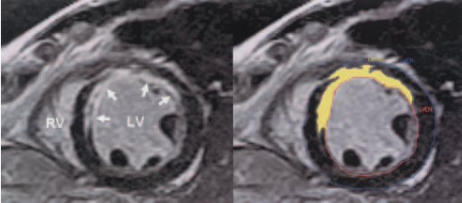
LGE, risk factor for cardiac death in ICM
195 patients, with known prior MI
Cardiac Mortality
Circulation. 2006;113:2733-2743.

Slide 11
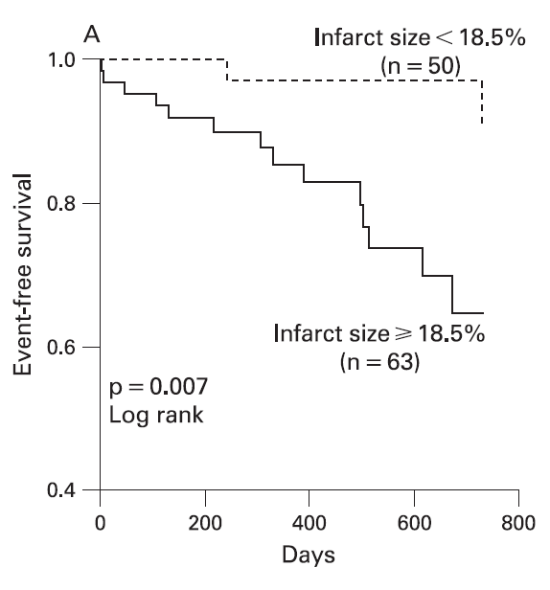
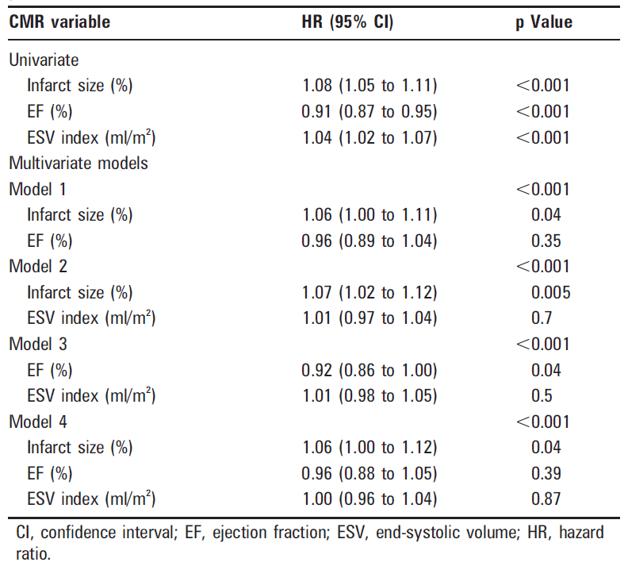
Infarct size by LGE-MRI
122 patients with STEMI following PCI
Primary end-point: all cause mortality, heart TPL
Median follow-up: 4.4 year
Heart 2007;94:730-6

Slide 12
LGE+; Meta-analysis
Ischemic and Non-ischemic
Sudden death, aborted sudden death, VT/VF, appropriate ICD therapy
Disertori et al. JACC Img. 2016;9:1046–55

Slide 13
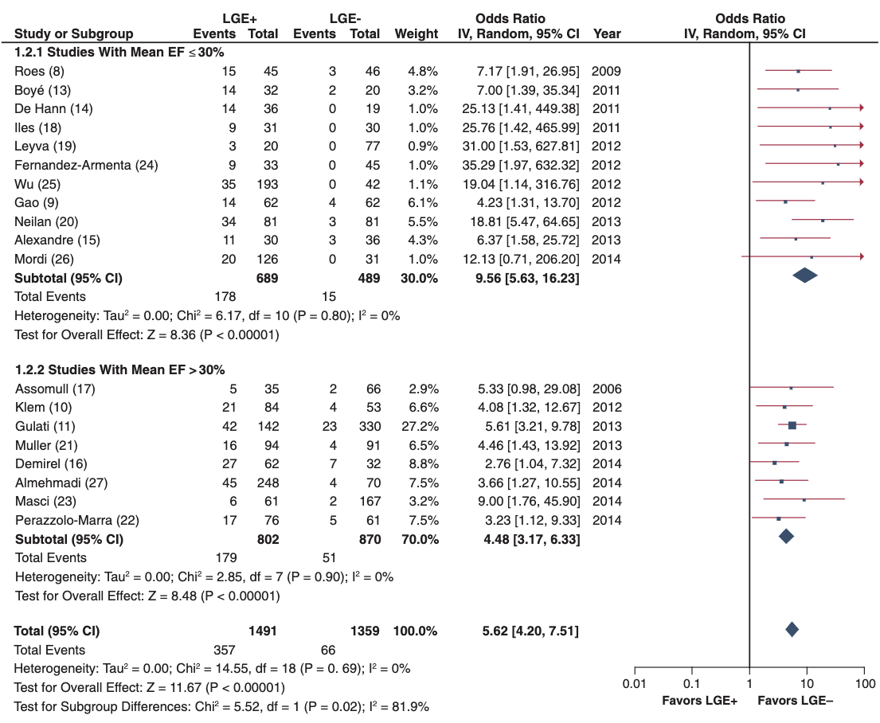
LGE+ Meta-analysis
Ischemic and Non-ischemic
Sudden death, aborted sudden death, VT/VF, appropriate ICD therapy
Disertori et al. JACC Img. 2016;9:1046–55

Slide 14
CMR techniques in risk stratification for SCD
Gräni, C. et al. JACC Img. 2020;13(10):2223–38.

Slide 15
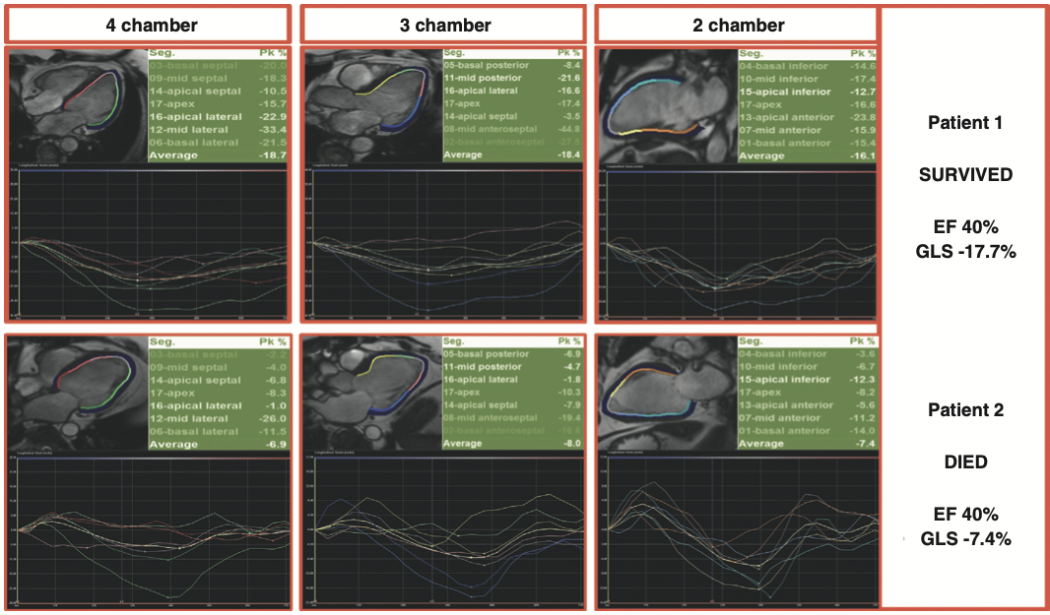
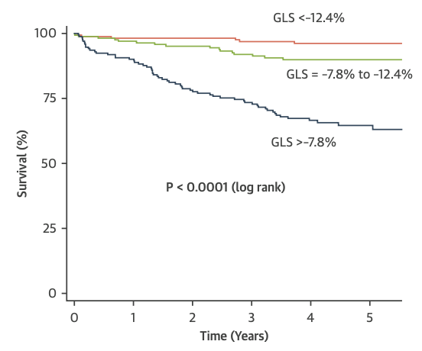
Feature-Tracking strain
iCMP patients
Romano et al. JACC Img. 2018;11:1419–29

Slide 16
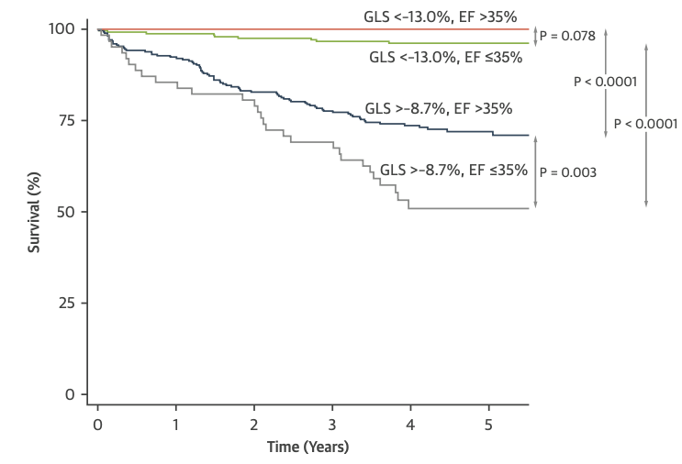
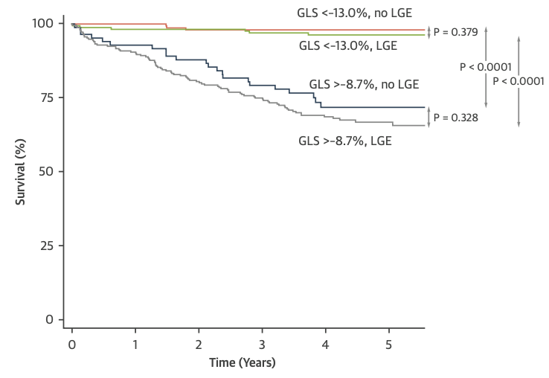
Global longitudinal strain
1,012 patients, LVEF < 50%, undergoing CMR
ischemic (49.9%) and non-ischemic (50.1%)
Romano et al. JACC Img. 2018;11:1419–29

Slide 17
SCD prevention in NICM
2017 ACC/AHA/HRS

Slide 18
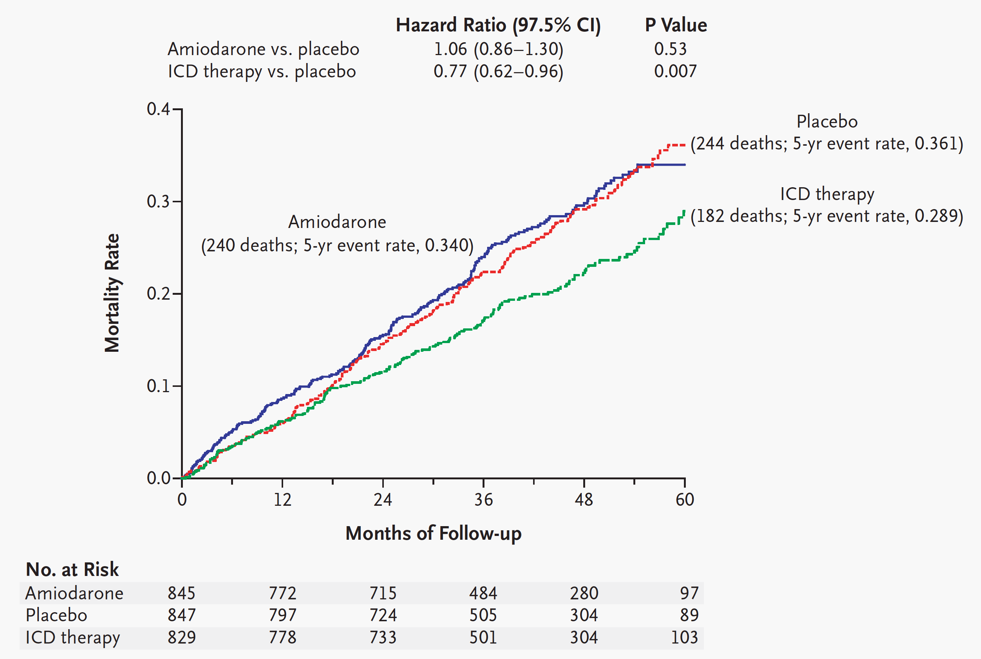
SCD-HeFT: ICD vs. Amiodarone for CHF
2,521 patients with NYHA II-III CHF, LVEF ≤ 35% (1,211 NICM)
NEJM 2005; 352;225-37

Slide 19
Prophylactic ICD in patients with NICM
458 patients with NICM, LVEF ≤ 36%
PVC or NS-VT
All cause death
Arrhythmic death
HR = 0.65 [0.40 - 1.06], p=0.08
HR = 0.20 [0.06 – 0.71], p=0.006
NEJM 2004; 350;2151-8

Slide 20
DANISH trial
All cause death
Sudden Cardiac Death
556 NICM, LVEF ≤ 35%
CRT ~ 58% in both group
Low event rate compared to previous studies
Kober et al. NEJM 2016

Slide 21
Scar – LGE in MRI
Gulati et al, JAMA, 309(9): 896, 2013

Slide 22
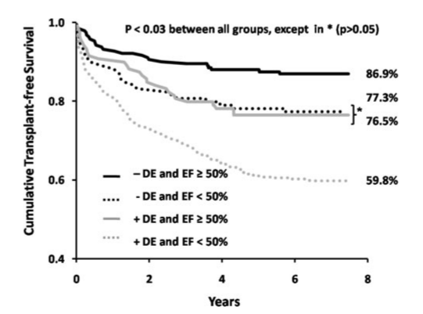
Myocardial Scar - Prognostic value independent of LVEF
857 consecutive patients with cine and LGE-MRI
Primary end-point: all cause mortality, heart TPL
Median follow-up: 4.4 year
EF ≥50%, LGE (-)
EF <50%, LGE (-)
EF ≥50%, LGE (+)
EF <50%, LGE (+)
Circulation 2009;120:2069-76

Slide 23
Midwall Fibrosis and Mortality - NICM
All cause death
SCD or aborted SCD
Gulati et al, JAMA, 309(9): 896, 2013

Slide 24
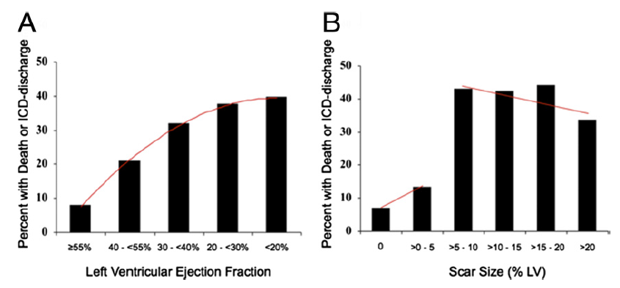
Myocardial Scar and SCD risk
137 patients (NICM 47%)
Median follow-up of 24 months
39 primary endpoint (death or appropriate ICD discharge for sustained VT)
LGE extent > 5%
HR 5.2 (95% CI 2.0-13.3)
Klem I., et al. JACC 2012;60:408-20

Slide 25
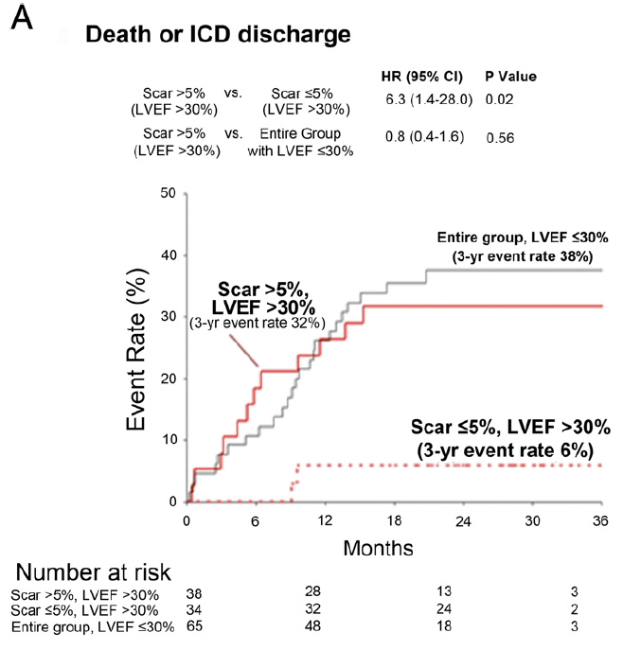
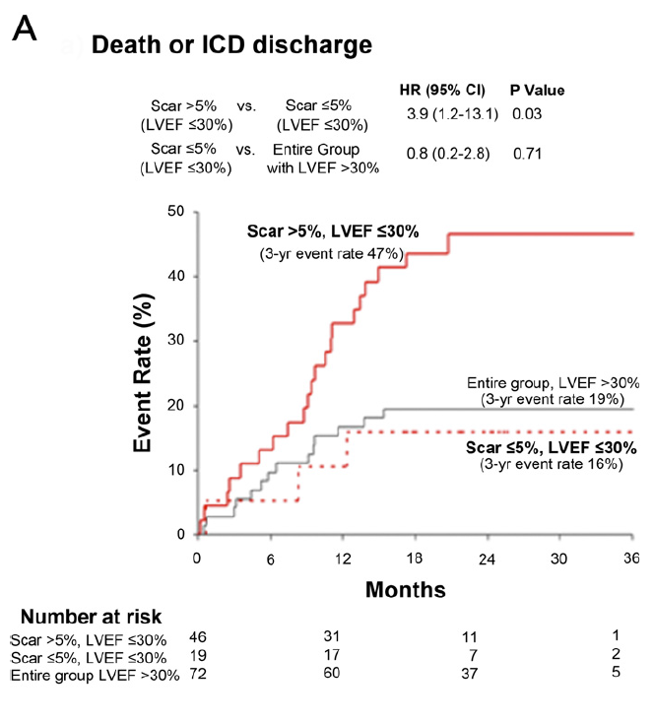
LVEF > 30%
LVEF ≤ 30%
Scar size > 5% : adjusted HR 4.59 (1.79-11.8), p = 0.002
Klem I., et al. JACC 2012;60:408-20

Slide 26
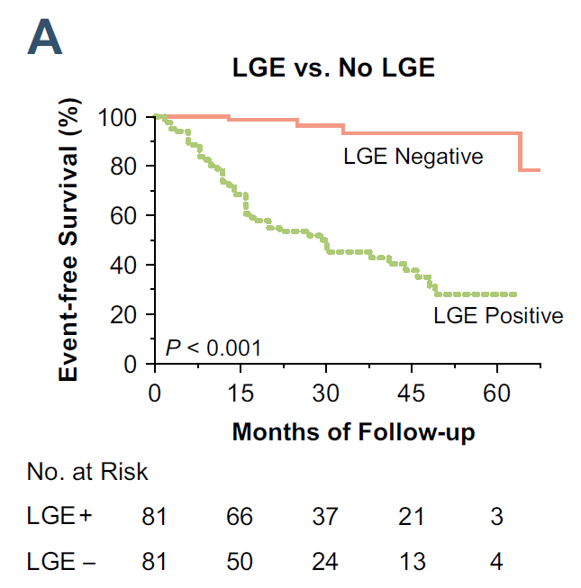
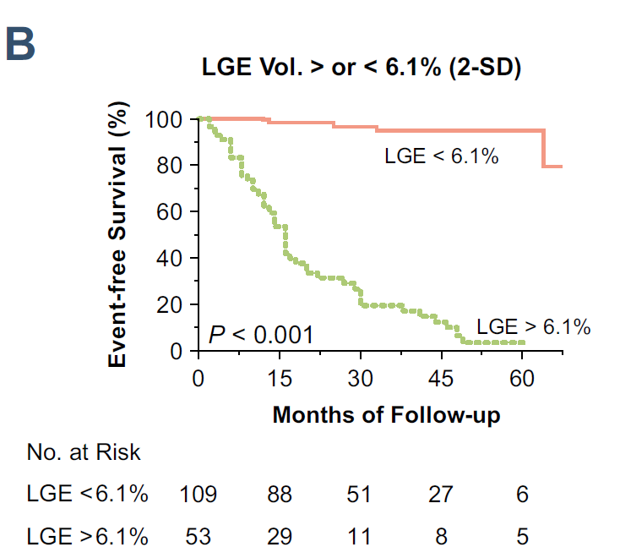
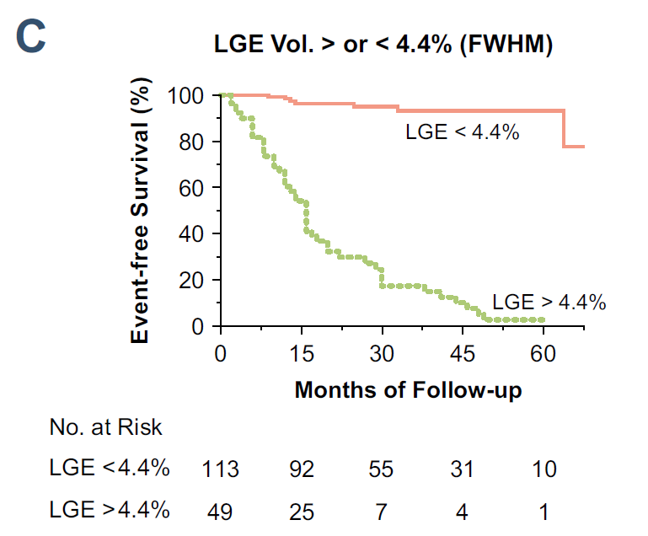
Myocardial scar quantification in DCMP
162 patients with nonischemic DCMP referred for ICD therapy
29 ± 18 months of follow-up
51 MACE (cardiovascular death, appropriate ICD therapy)
Neilan TG., et al. JACC Imag 2013;6:944-54

Slide 27
Meta-analysis; LGE+
1443 NICM
Composite arrhythmic outcomes – SCD, aborted SCD, VT/VF, appropriate ICD shock
favors LGE+
favors LGE-
Disertori M et al, JACC cardiovasc imaging. 2016

Slide 28
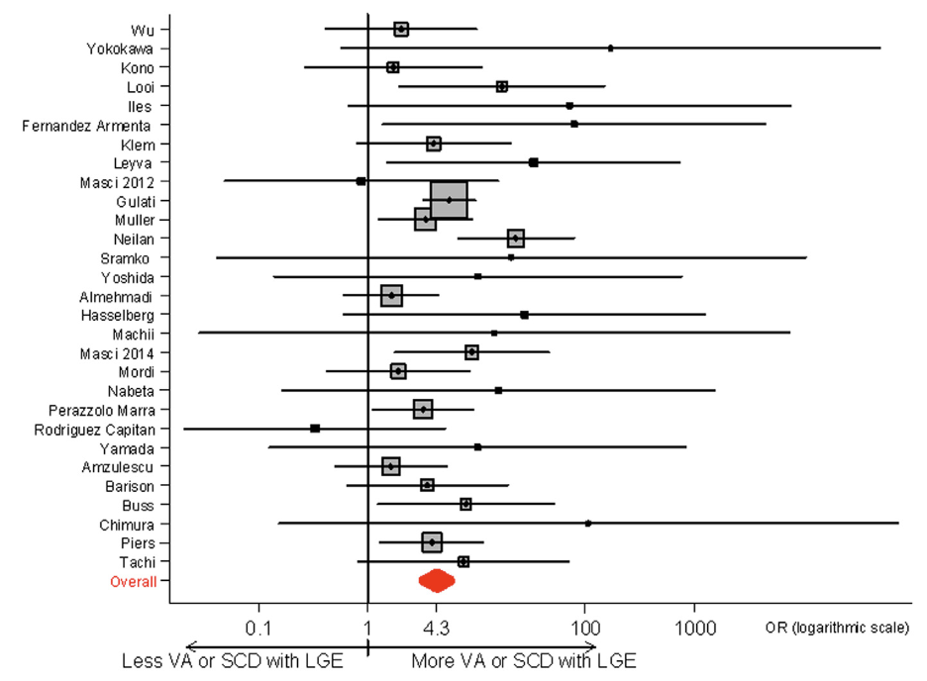
Meta-analysis
29 studies, 2,948 DCM patients
J Am Coll Cardiol HF 2017;5:28–38

Slide 29
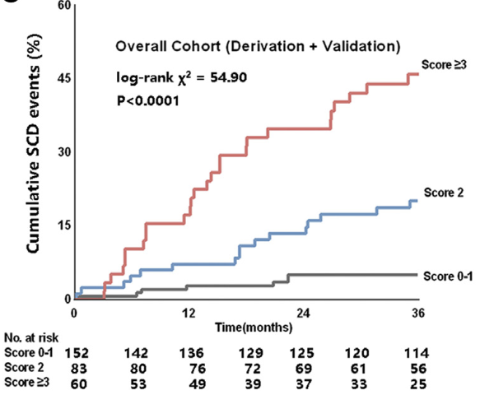
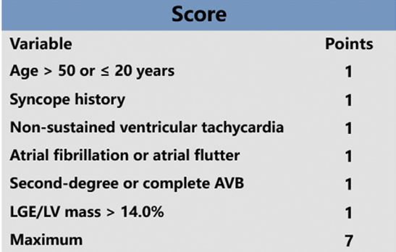
ESTIMATED score
Canadian Journal of Cardiology 36 (2020) 1121 - 1129
Notes:
We recruited 395 consecutive middle-aged patients with NIDCM and performed 3-year follow-up for SCD events. The score was developed and veriﬁed in 295 primary prevention patients, and the predictive value was conﬁrmed by comparing the SCD events between the high-risk patients stratiﬁed by the score and 100 secondary prevention patients.

Slide 30
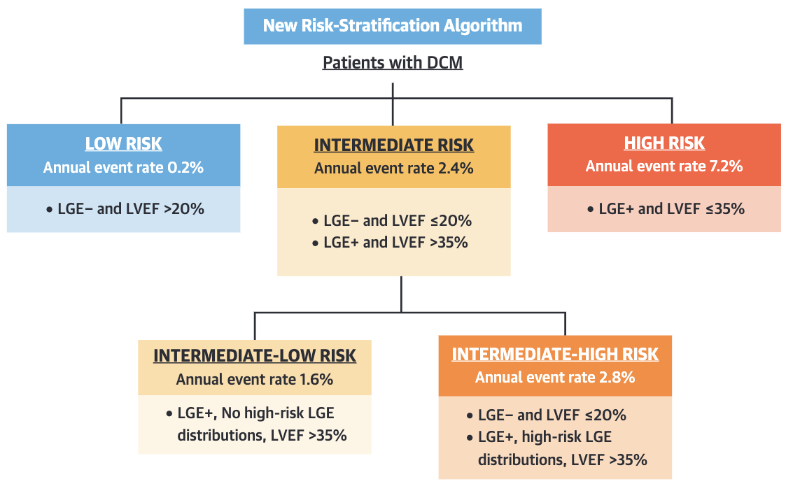
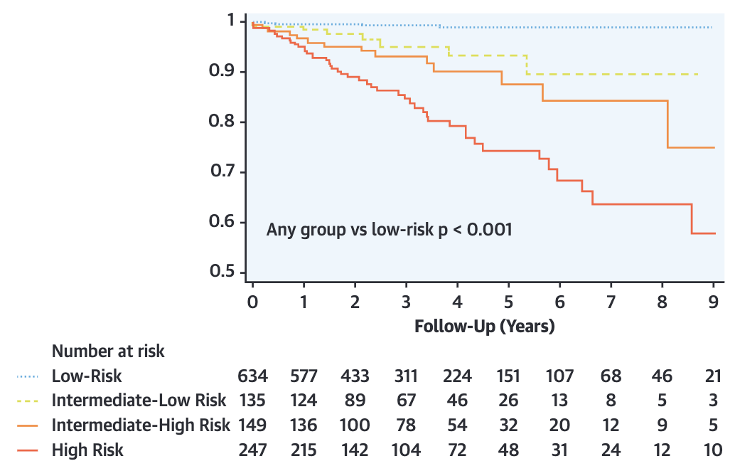
Risk stratification in NIDCM
Retrospective cohort study
1,165 NIDCM patients
Endpoint; ICD therapies, sustained VT, rCA, sudden death
High risk LGE distribution;
epicardial, transmural, or combined septal and free-wall
J Am Coll Cardiol 2021;77:2890–905)
Notes:
High risk LGE; epicardial, transmural, combined septal and free-wall

Slide 31
Summary
Risk stratification in ICM, NICM
LVEF
Role of CMR
LGE, quantification
Feature tracking strain

Slide 32
감사합니다
Thank you!

